Slide 1
Introduction to Computational Thermodynamics
Section 3.3
Chemical Stability Analysis

Slide 2
Introduction
Stability analysis deals with the question “does a phase-split occur?”
This helps us determine if a single-phase solution is correct, or if further calculation is necessary
If further calculation is required, stability analysis can provide good initial guesses

Slide 3
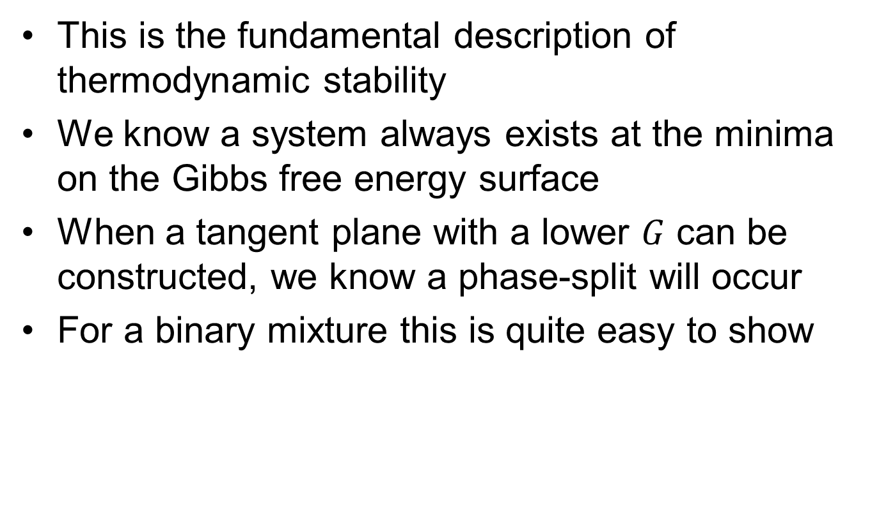
The Gibbs tangent-plane
This is the fundamental description of thermodynamic stability
We know a system always exists at the minima on the Gibbs free energy surface
When a tangent plane with a lower $G$ can be constructed, we know a phase-split will occur
For a binary mixture this is quite easy to show

Slide 4
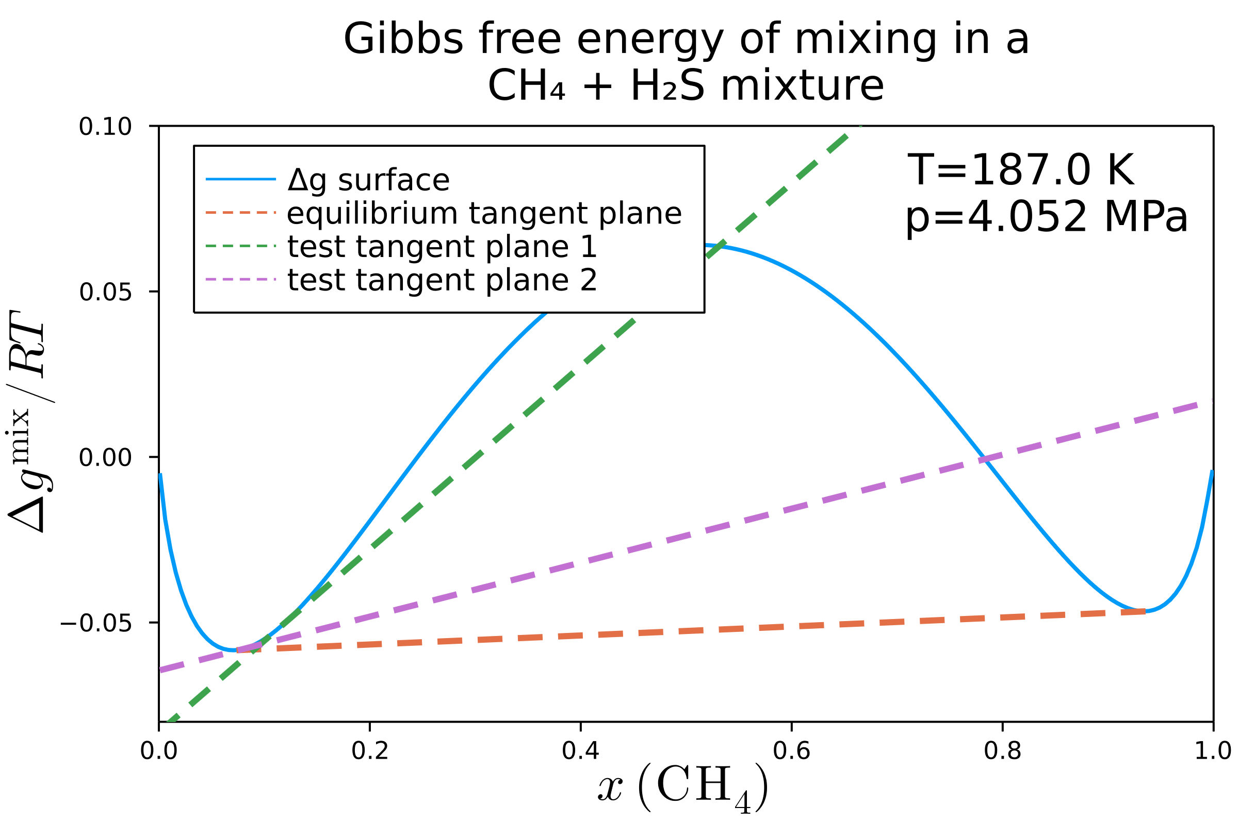
The Gibbs tangent-plane
Any plane tangent at one point signifies instability
However, there is only one cotangent plane – this shows the resulting phase split compositions

Slide 5
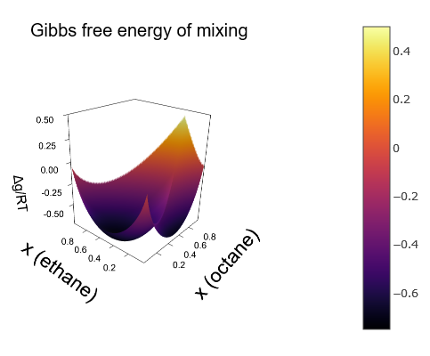
The Gibbs tangent-plane
If we look at a ternary mixture of ethane, octane, and propane it becomes far harder to see where exactly the phase split occurs
Ternary diagram

Slide 6
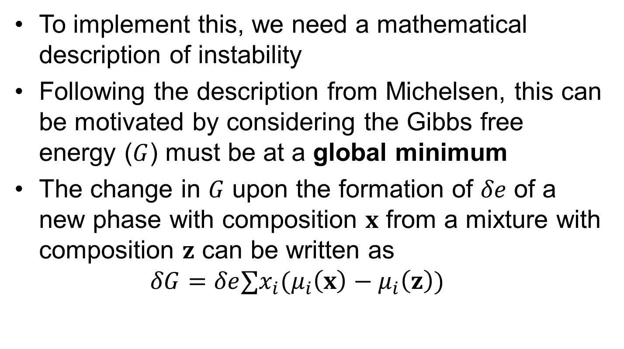
Mathematical description
To implement this, we need a mathematical description of instability
Following the description from Michelsen, this can be motivated by considering the Gibbs free energy ($G$) must be at a global minimum
The change in $G$ upon the formation of $δe$ of a new phase with composition $x$ from a mixture with composition $z$ can be written as $δG=δe∑x_{i}(μ_{i}\left(x\right)−μ_{i}\left(z\right))$

Slide 7
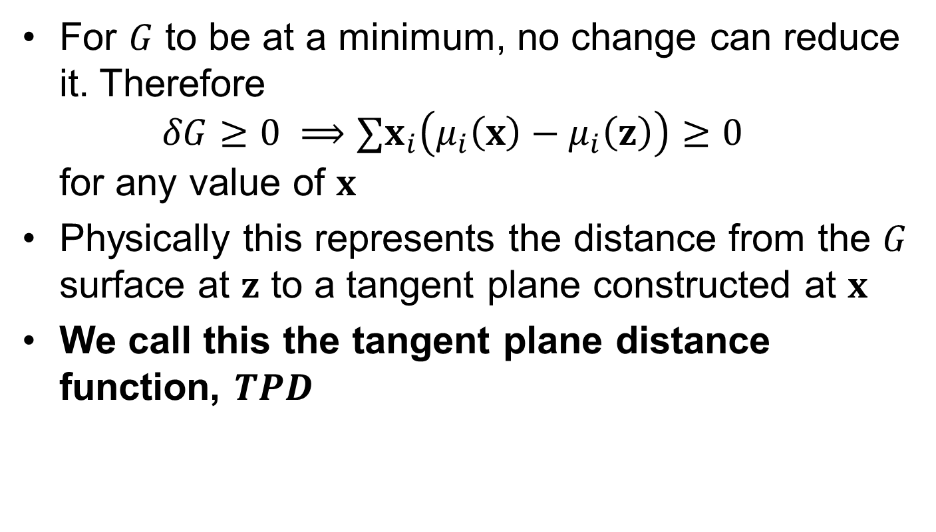
Mathematical description
For $G$ to be at a minimum, no change can reduce it. Therefore $δG≥0 ⟹∑x_{i}\left(μ_{i}\left(x\right)−μ_{i}\left(z\right)\right)≥0$ for any value of $x$
Physically this represents the distance from the $G$ surface at $z$ to a tangent plane constructed at $x$
We call this the tangent plane distance function, $TPD$

Slide 8
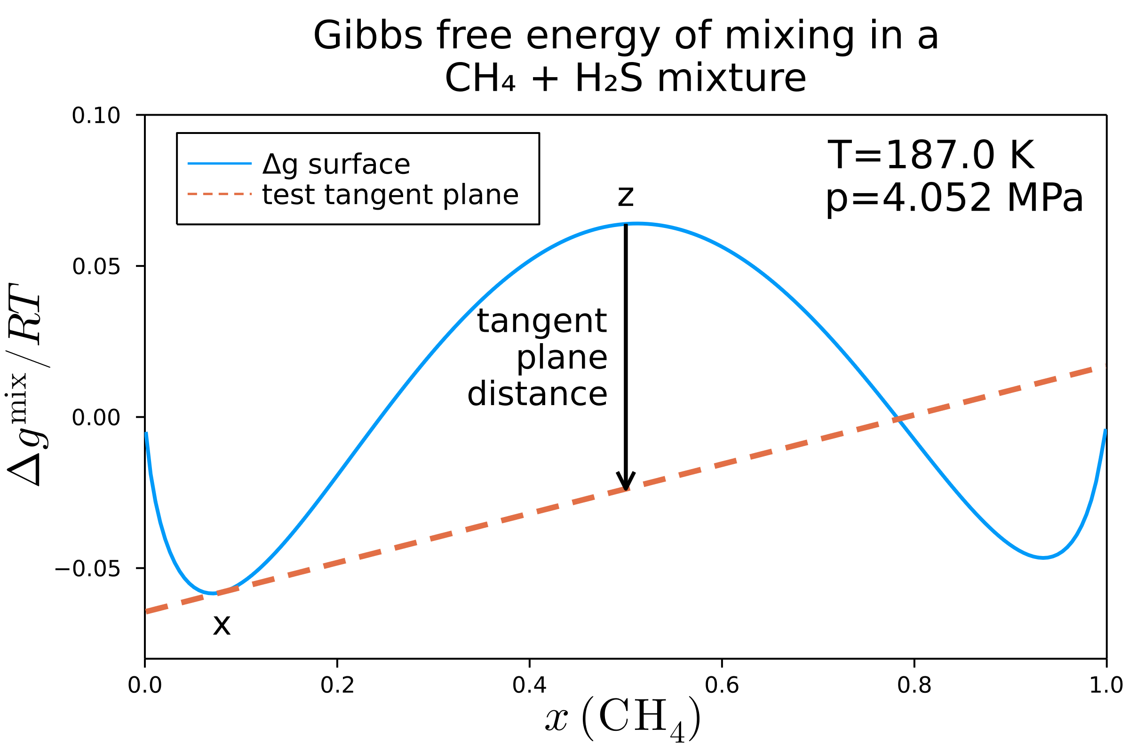

Mathematical description
Our function describing chemical stability is then $TPD\left(x\right)=∑x_{i}\left(μ_{i}\left(x\right)−μ_{i}\left(z\right)\right)$

Slide 9
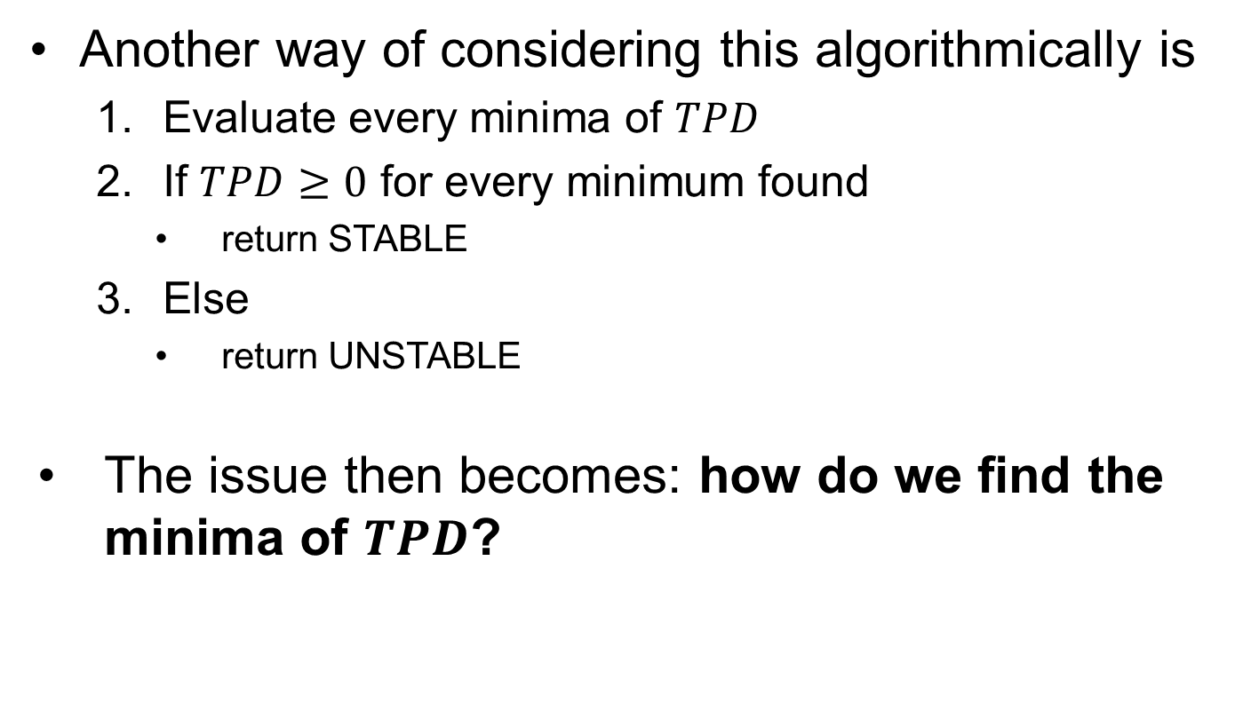
Mathematical description
Another way of considering this algorithmically is
Evaluate every minima of $TPD$
If $TPD≥0$ for every minimum found
return STABLE
Else
return UNSTABLE
The issue then becomes: how do we find the minima of $TPD$?

Slide 10
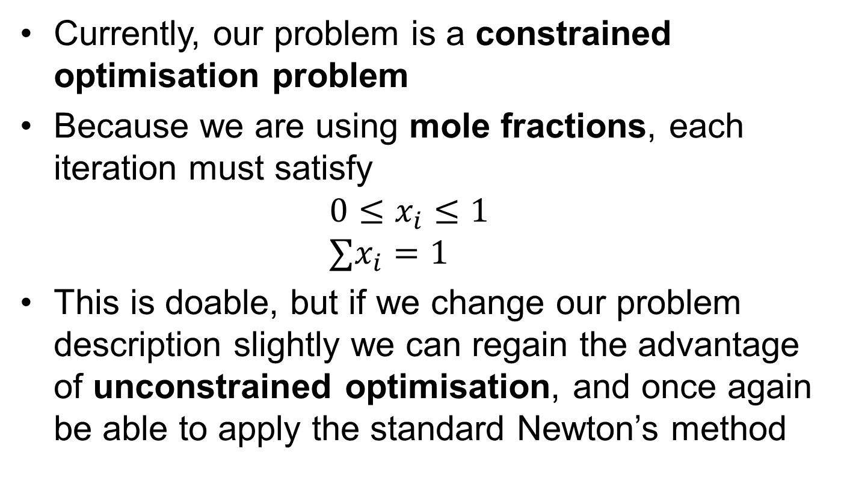
Numerical issues
Currently, our problem is a constrained optimisation problem
Because we are using mole fractions, each iteration must satisfy $0≤x_{i}≤1$ $∑x_{i}=1$
This is doable, but if we change our problem description slightly we can regain the advantage of unconstrained optimisation, and once again be able to apply the standard Newton’s method

Slide 11
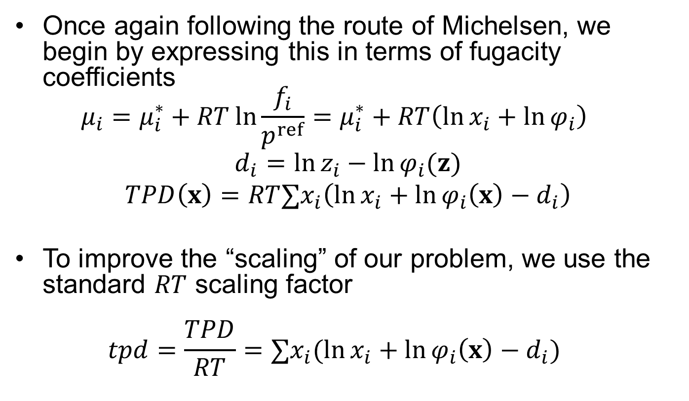
Improved formulation
Once again following the route of Michelsen, we begin by expressing this in terms of fugacity coefficients $μ_{i}=μ_{i}^{∗}+RT\ln{\frac{f_{i}}{p^{ref}}}=μ_{i}^{∗}+RT\left(\ln{x_{i}}+\ln{φ_{i}}\right)$
$$d_{i}=\ln{z_{i}−\ln{φ_{i}(z)}} \\ TPD\left(x\right)=RT∑x_{i}\left(\ln{x_{i}}+\ln{φ_{i}\left(x\right)}−d_{i}\right)$$
To improve the “scaling” of our problem, we use the standard $RT$ scaling factor $tpd=\frac{TPD}{RT}=∑x_{i}(\ln{x_{i}}+\ln{φ_{i}\left(x\right)}−d_{i})$

Slide 12
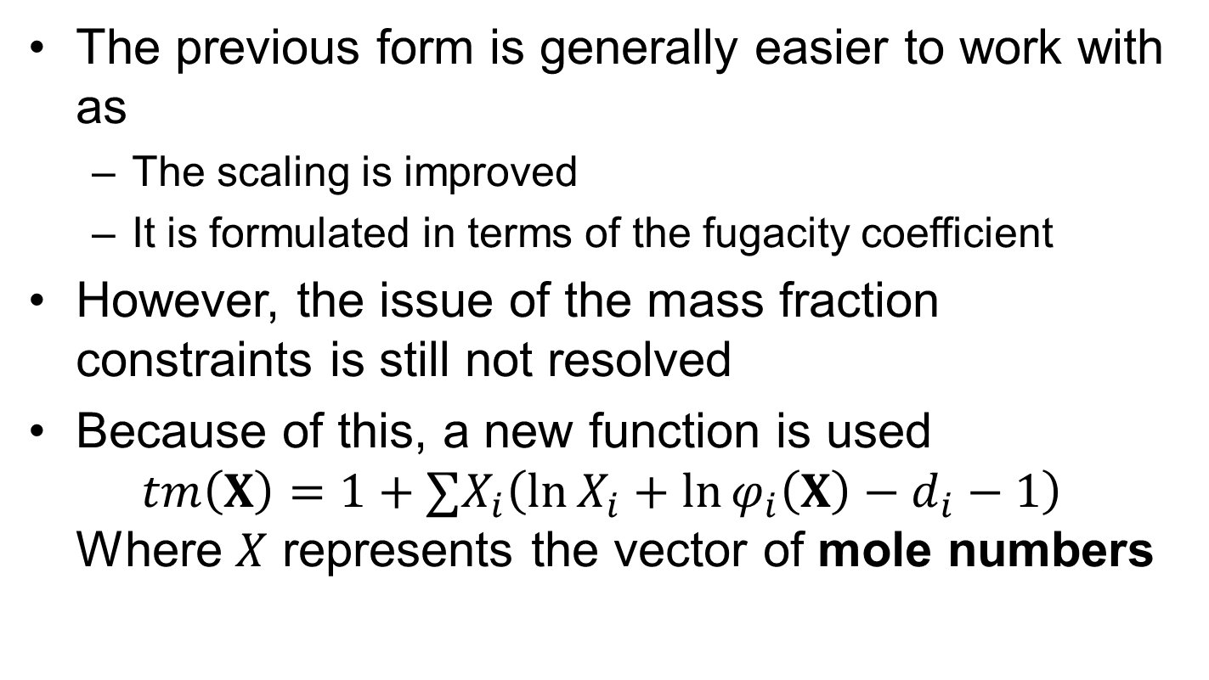
Unconstrained formulation
The previous form is generally easier to work with as
The scaling is improved
It is formulated in terms of the fugacity coefficient
However, the issue of the mass fraction constraints is still not resolved
Because of this, a new function is used $tm\left(X\right)=1+∑X_{i}\left(\ln{X_{i}}+\ln{φ_{i}\left(X\right)}−d_{i}−1\right)$ Where $X$ represents the vector of mole numbers

Slide 13
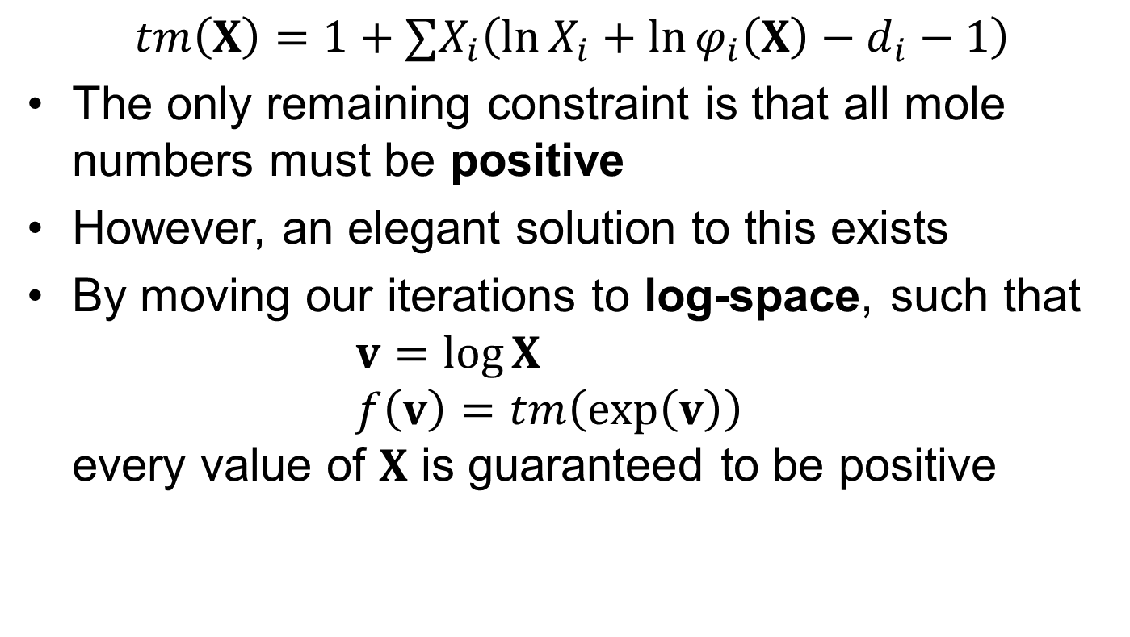
Unconstrained formulation
$$tm\left(X\right)=1+∑X_{i}\left(\ln{X_{i}}+\ln{φ_{i}\left(X\right)}−d_{i}−1\right)$$
The only remaining constraint is that all mole numbers must be positive
However, an elegant solution to this exists
By moving our iterations to log-space, such that $v=\log{X}$ $f\left(v\right)=tm\left(\exp\left(v\right)\right)$ every value of $X$ is guaranteed to be positive

Slide 14
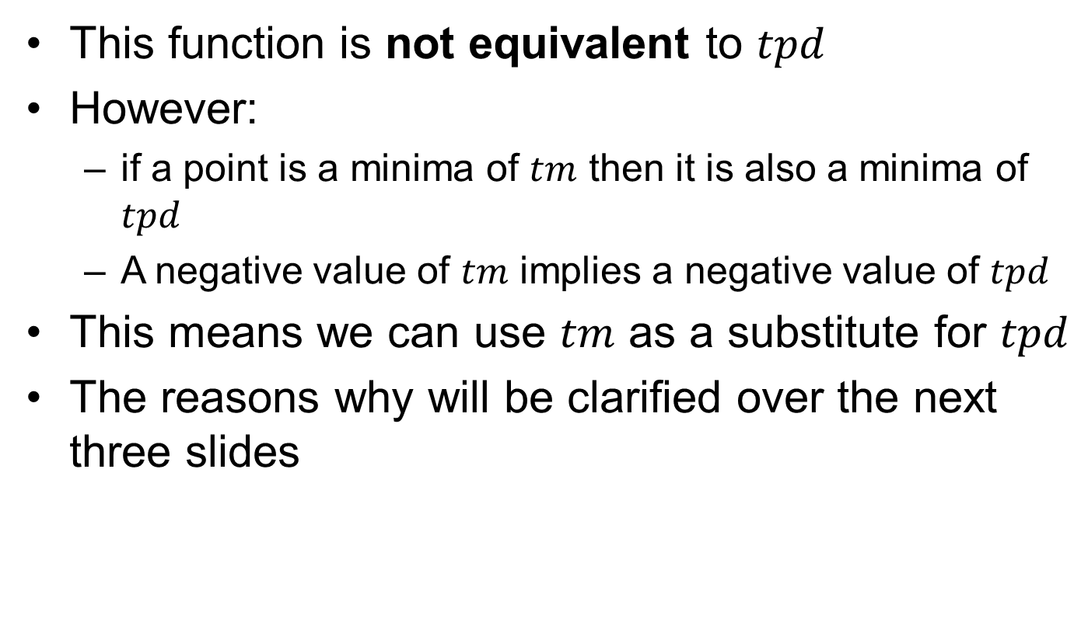
Unconstrained formulation
This function is not equivalent to $tpd$
However:
if a point is a minima of $tm$ then it is also a minima of $tpd$
A negative value of $tm$ implies a negative value of $tpd$
This means we can use $tm$ as a substitute for $tpd$
The reasons why will be clarified over the next three slides

Slide 15
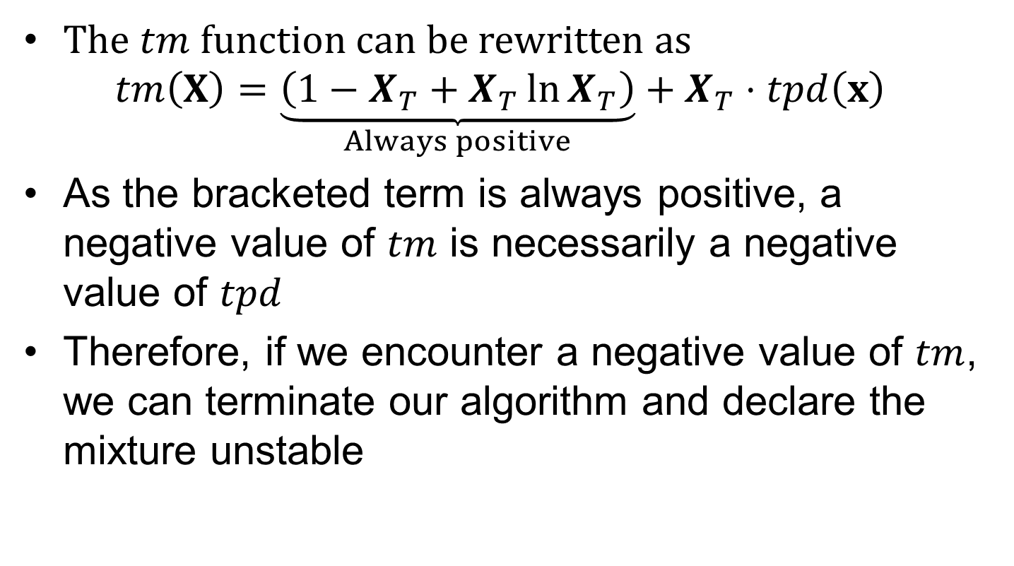
Unconstrained formulation
The $tm$ function can be rewritten as
$$tm\left(X\right)=\underset{Always positive}{\underbrace{\left(1−X_{T}+X_{T}\ln{X_{T}}\right)}}+X_{T}⋅tpd\left(x\right)$$
As the bracketed term is always positive, a negative value of $tm$ is necessarily a negative value of $tpd$
Therefore, if we encounter a negative value of $tm$, we can terminate our algorithm and declare the mixture unstable

Slide 16
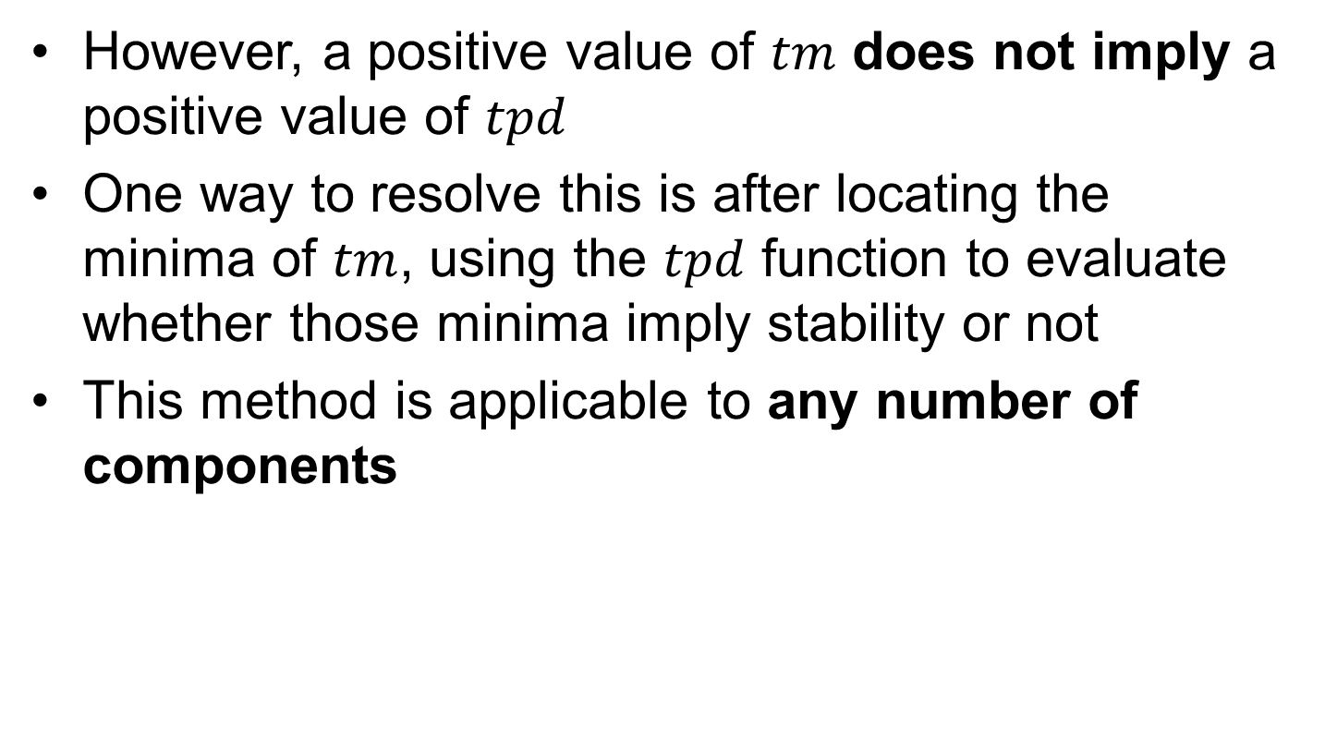
Unconstrained formulation
However, a positive value of $tm$ does not imply a positive value of $tpd$
One way to resolve this is after locating the minima of $tm$, using the $tpd$ function to evaluate whether those minima imply stability or not
This method is applicable to any number of components

Slide 17

Implementation
We will split the implementation into three stages:
Specify state and model
Generate initial guesses
Minimise objective function $tm$

Slide 18
1. State and model specification
For a phase split to occur, we must have non-ideal mixing
To capture this, we must have a prediction for the binary interaction parameters
I have chosen the Extended Predictive Peng Robinson-78 (EPPR78)
For our mixture we use methane and hydrogen sulfide evaluated at 187 K, 4.052 MPa
This is a state used by Michelsen (the reasons will become clear)

Slide 19
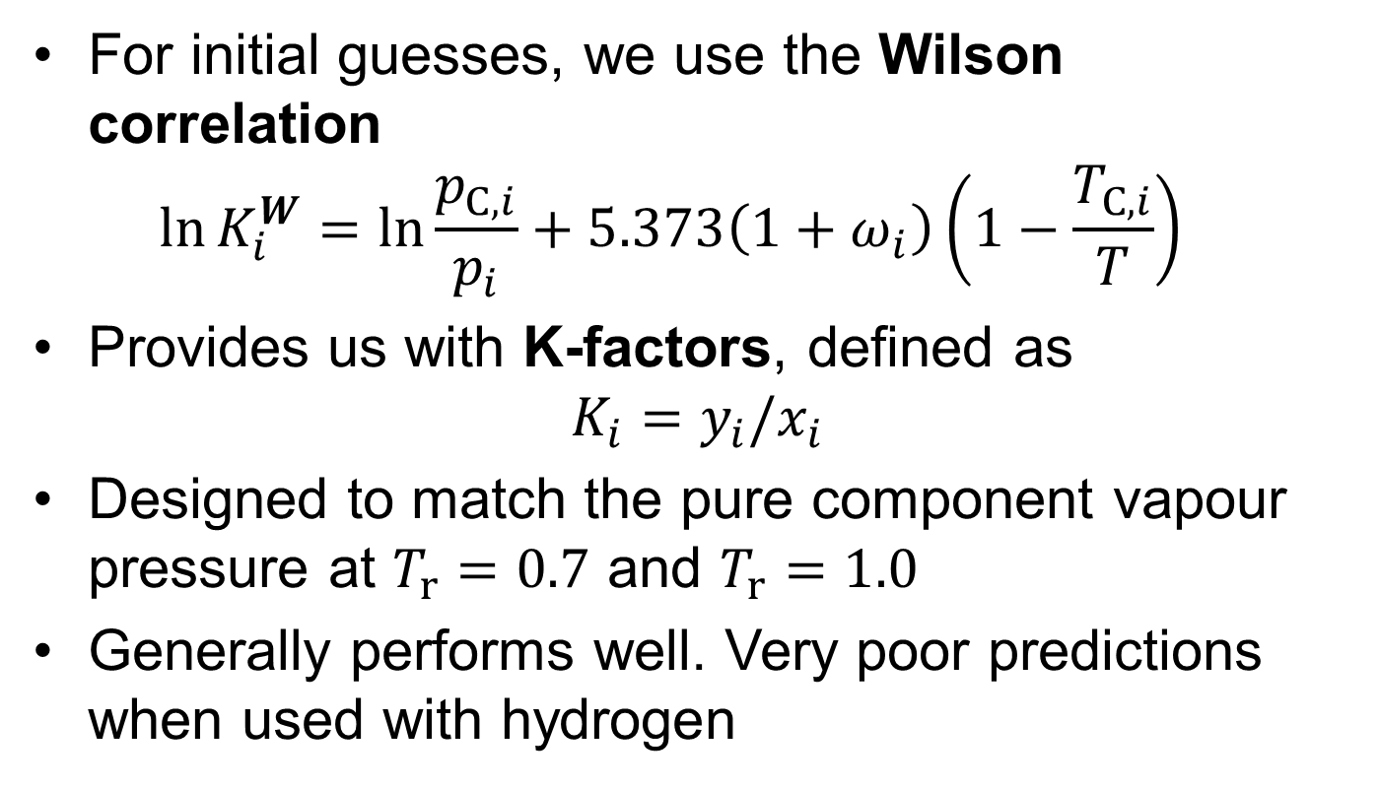
2. Initial guesses
For initial guesses, we use the Wilson correlation $\ln{K_{i}^{W}}=\ln{\frac{p_{C,i}}{p_{i}}}+5.373\left(1+ω_{i}\right)\left(1−\frac{T_{C, i}}{T}\right)$
Provides us with K-factors, defined as $K_{i}=y_{i}/x_{i}$
Designed to match the pure component vapour pressure at $T_{r}=0.7$ and $T_{r}=1.0$
Generally performs well. Very poor predictions when used with hydrogen

Slide 20
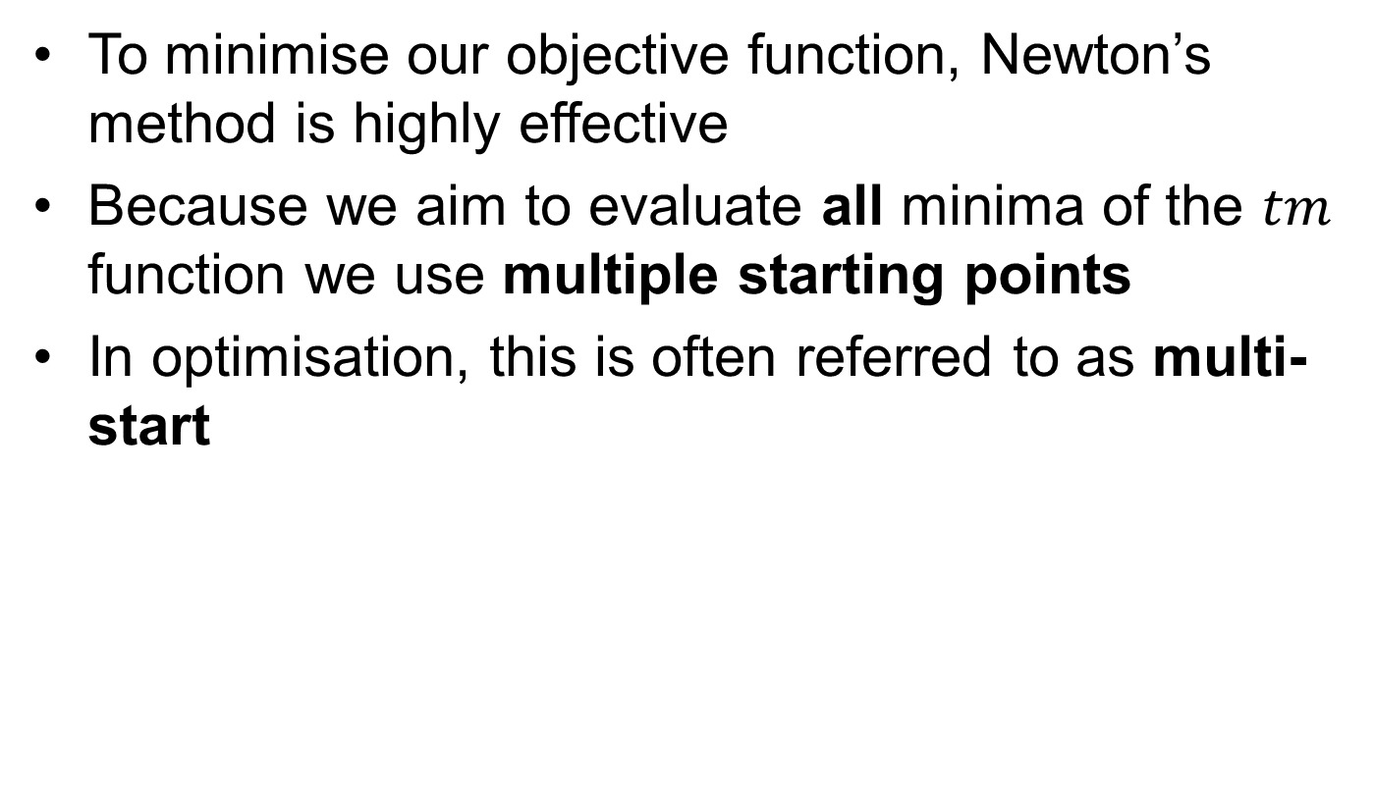

3. Minimise $tm$
To minimise our objective function, Newton’s method is highly effective
Because we aim to evaluate all minima of the $tm$ function we use multiple starting points
In optimisation, this is often referred to as multi-start

Slide 21
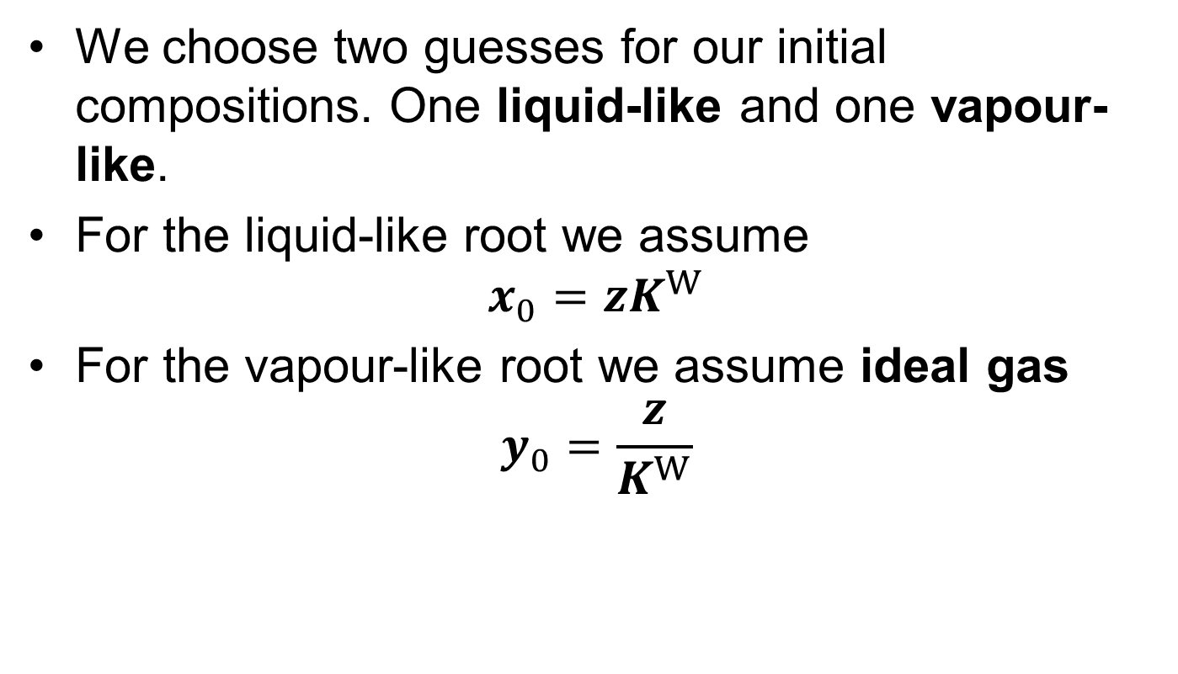
3. Minimise $tm$
We choose two guesses for our initial compositions. One liquid-like and one vapour-like.
For the liquid-like root we assume $x_{0}=zK^{W}$
For the vapour-like root we assume ideal gas $y_{0}=\frac{z}{K^{W}}$

Slide 22
3. Minimise $tm$
Switch to notebook and show implementation

Slide 23
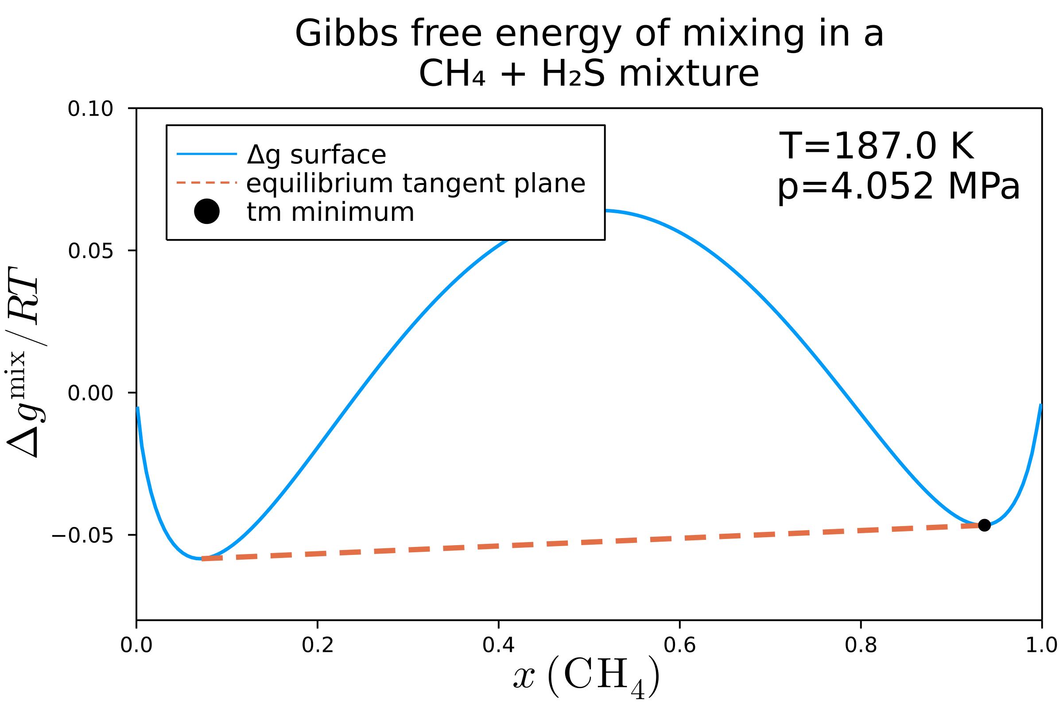
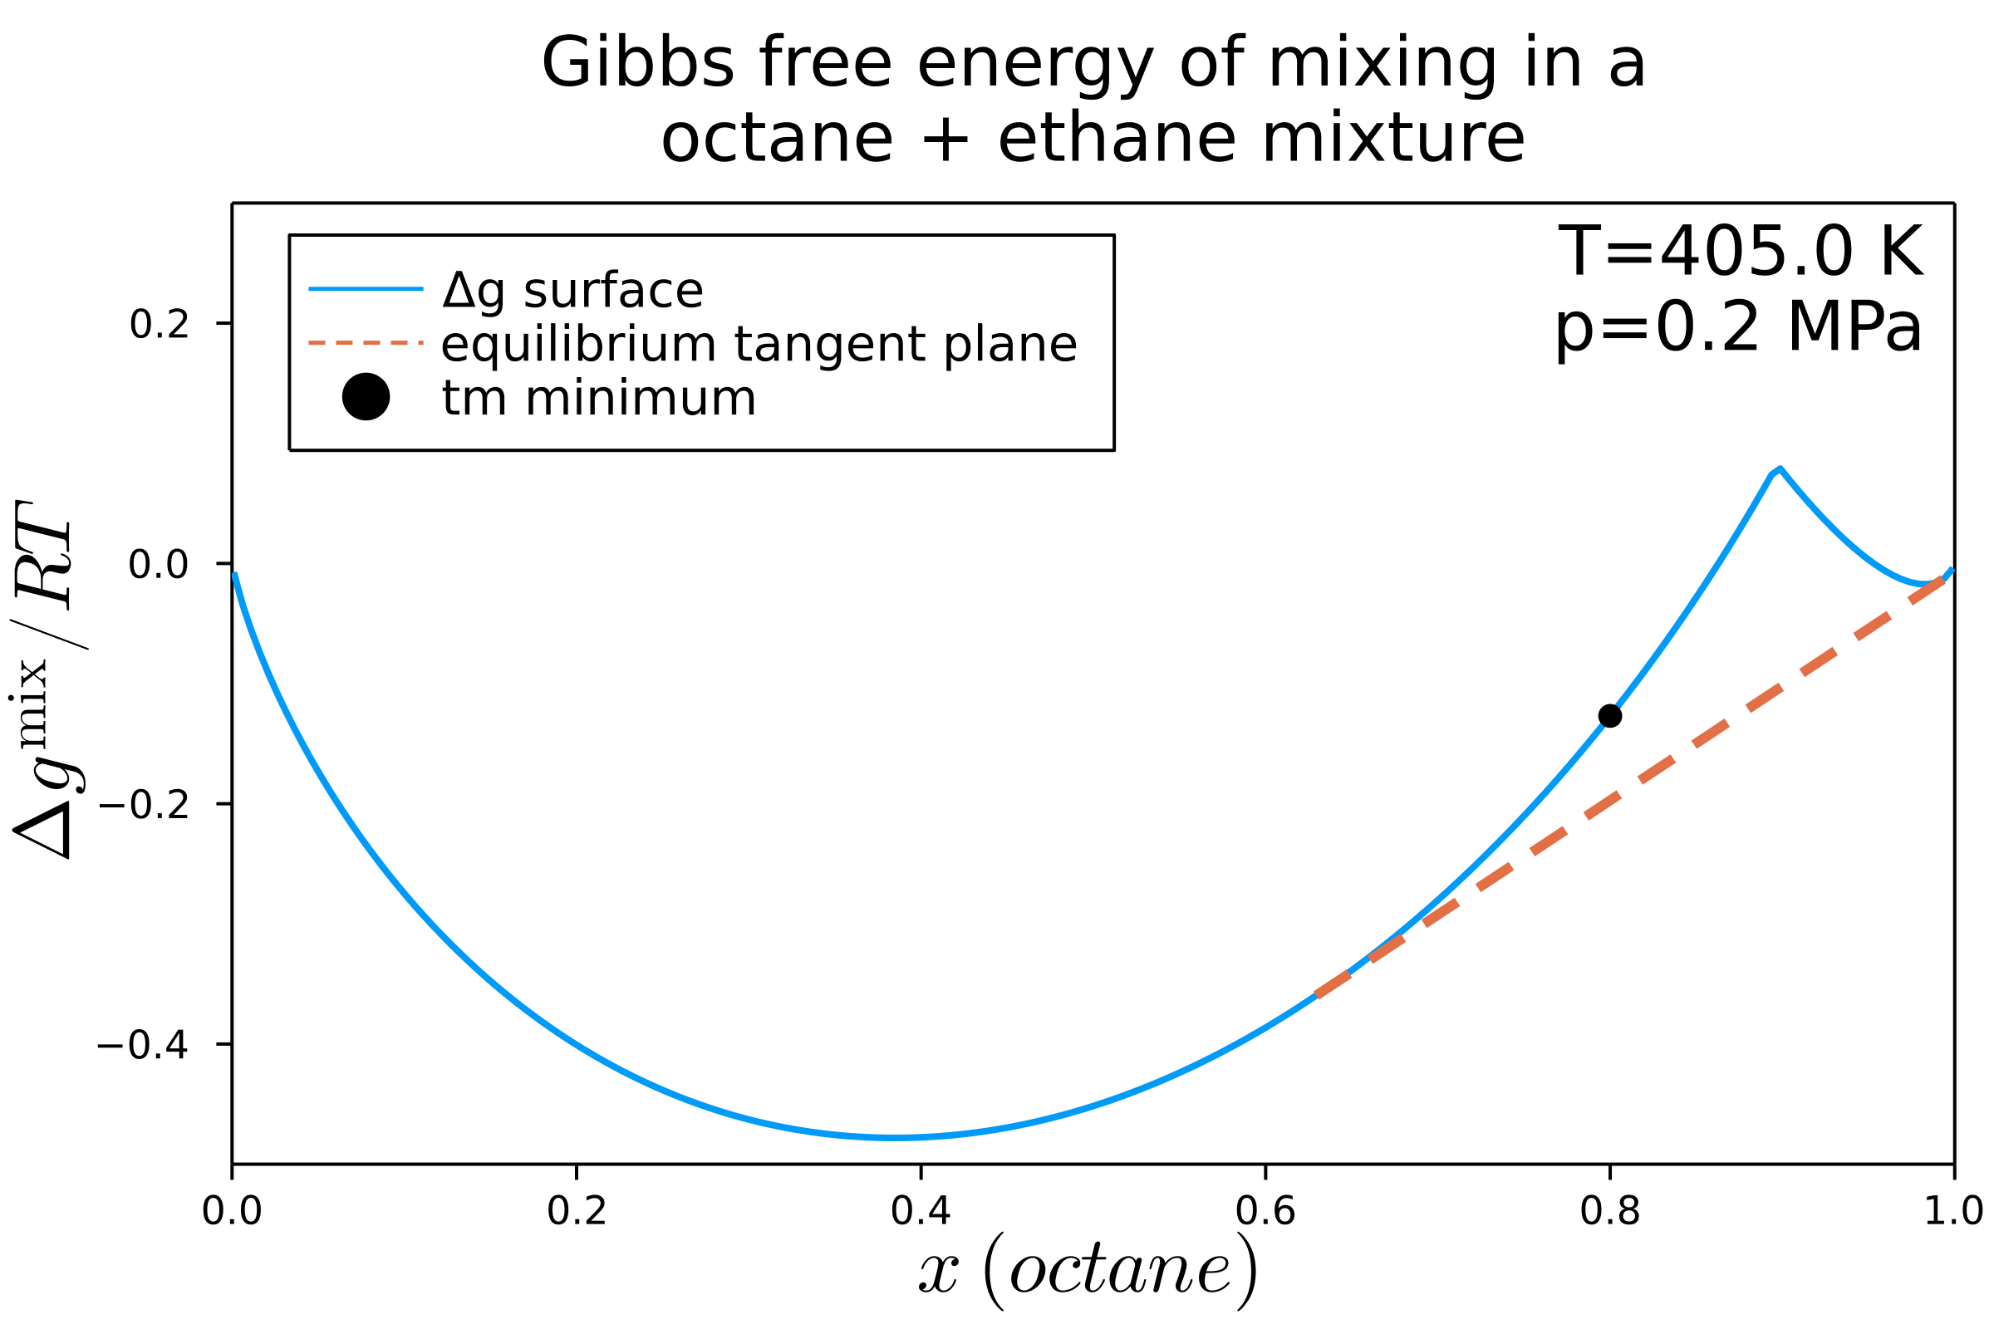
Equilibrium guesses
One of the key applications of stability analysis is providing good “guesses” of equilibrium

Slide 24
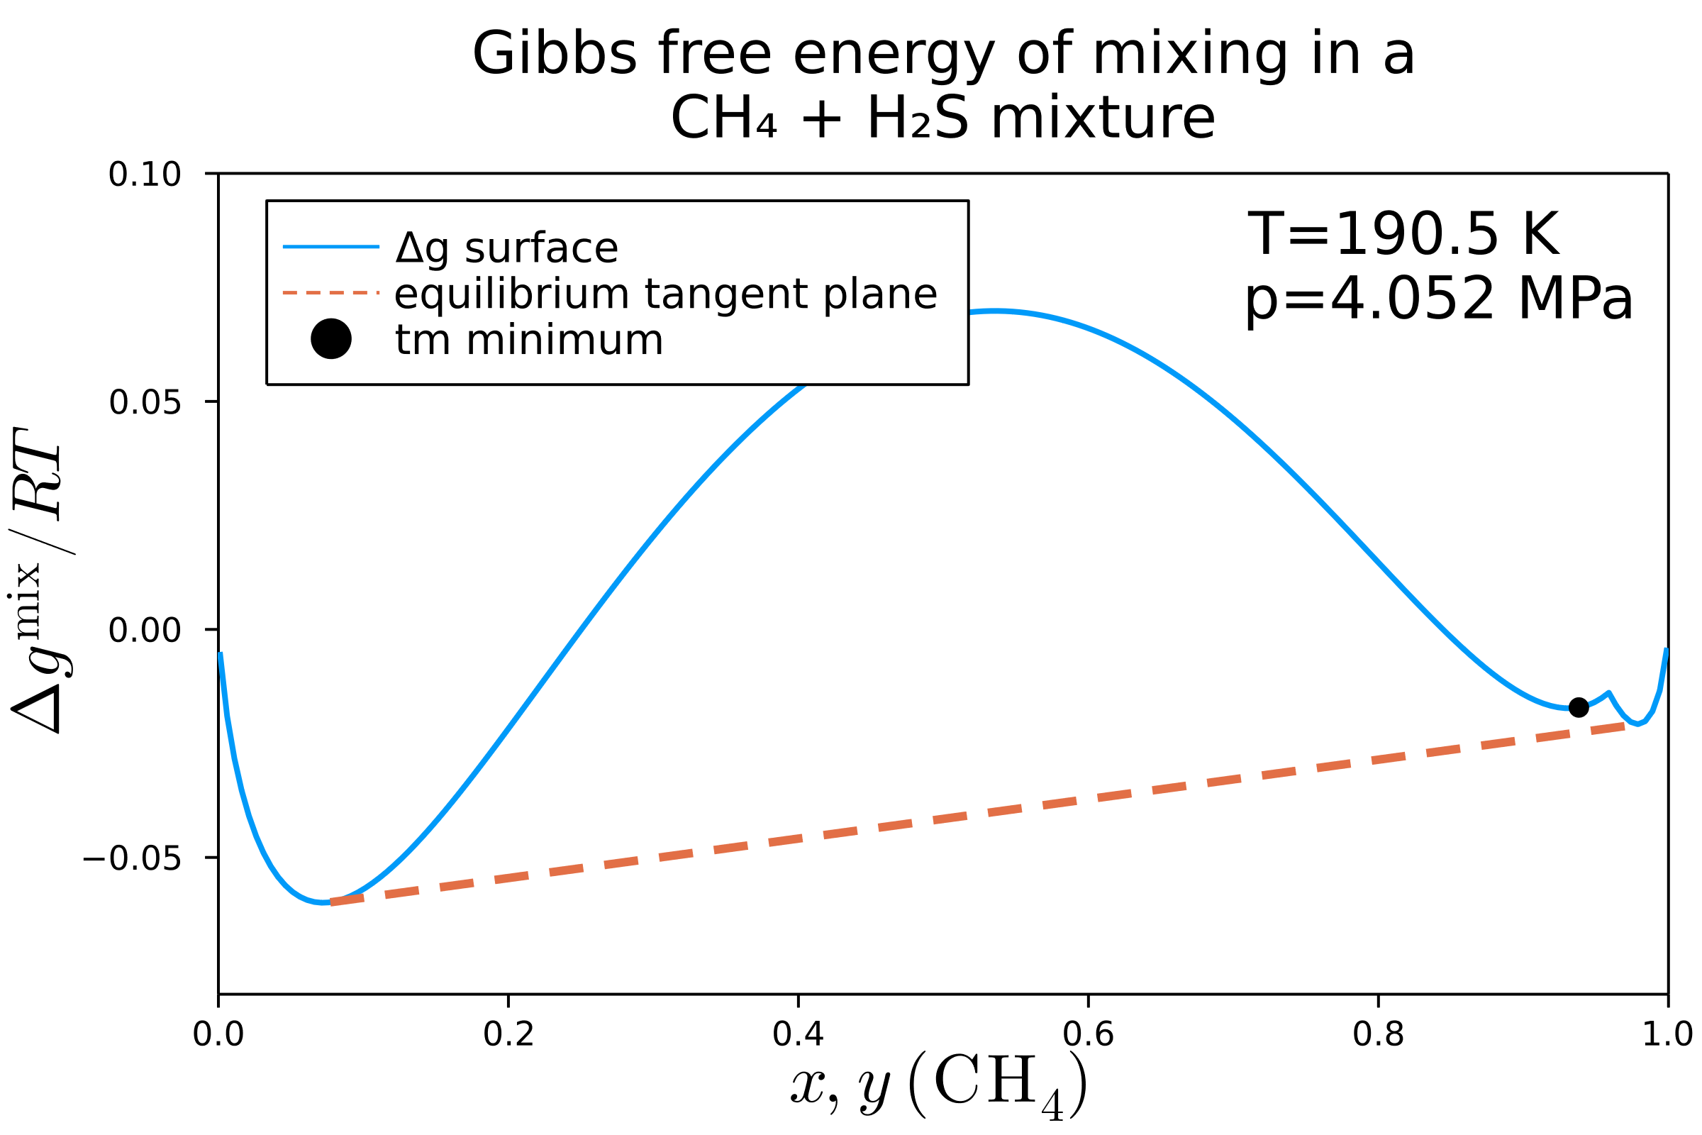
Difficulties
Our stability analysis algorithm is not invincible
In some cases, we may converge to an incorrect minima
This may result in an unstable phase being reported as stable

Slide 25
Difficulties
Luckily, this problem is rare
To avoid it, modifications to our method are required. These generally intend to “globalise” our optimisation technique.
They include:
More points!
Tunnelling
Stochastic methods (e.g. evolutionary algorithms, simulated annealing)
Usually these are not necessary

Slide 26
Key points

